Slide 1

String Handling

Slide 2
What is String?
String
As we know about string anyways but a lot more about string is there.
Strings in python are surrounded by either single quotation marks, or double quotation marks.
'hello' is the same as "hello".
You can display a string literal with the print() function:
Print(‘hello’)
Print(“hello”)
output :
hello
hello

Slide 3
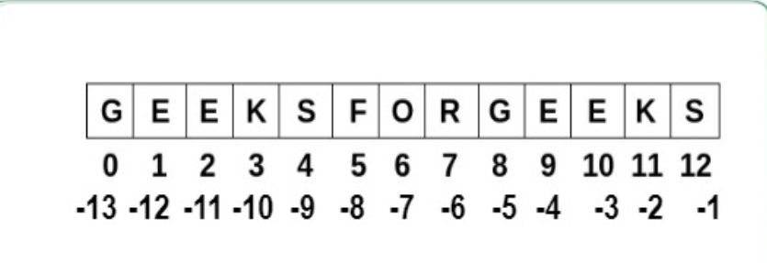
String as array

Slide 4
String
Strings are stored as arrays
And each character in string are having index value starting from 0
From the end the index value starts from -1.

Slide 5
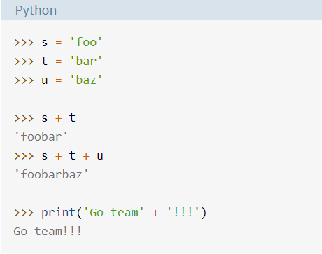
String Operators
The + operator
  Concatenates strings.
  Example:

Slide 6
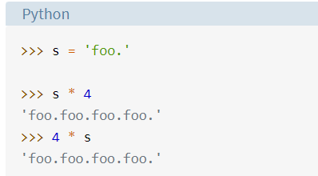
The * operator
This creates multiple copies of the string.
Example :

Slide 7
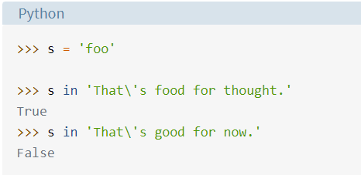
The in operator
The in operator returns true if the first operand is contained in within second or returns false.

Slide 8
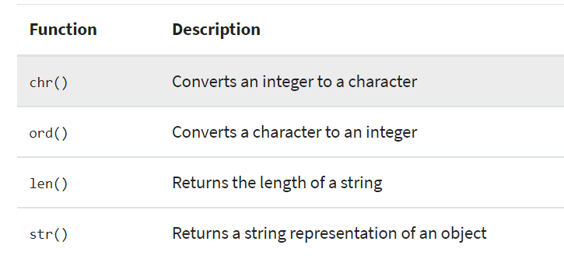
String Functions

Slide 9
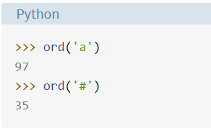
ord
This gives the ASCII value of the character given.
Example :

Slide 10
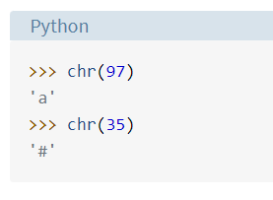
chr
This gives the character when ASCII value is provided.
Example:

Slide 11
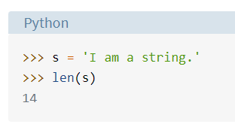
len
Returns the length of a string.
Example :

Slide 12

Exercise Question
Write a program to get an output like this:
  s1 = "You“
  s2 = "Have“
  s3 = "Done“
  s4 = "Good Job"

Slide 13
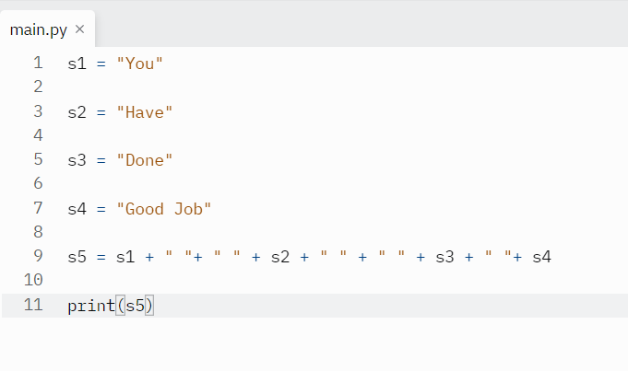
Program

Slide 14
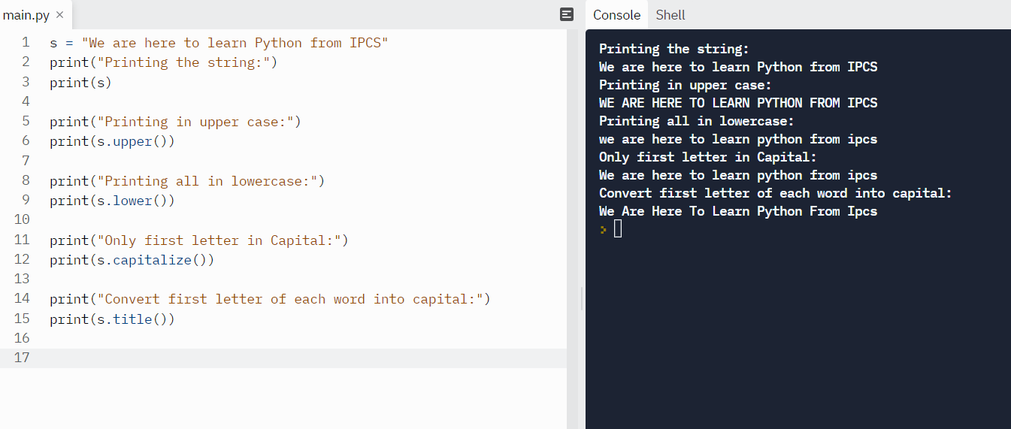
Upper, lower, capitalize, title, replace, count

Slide 15
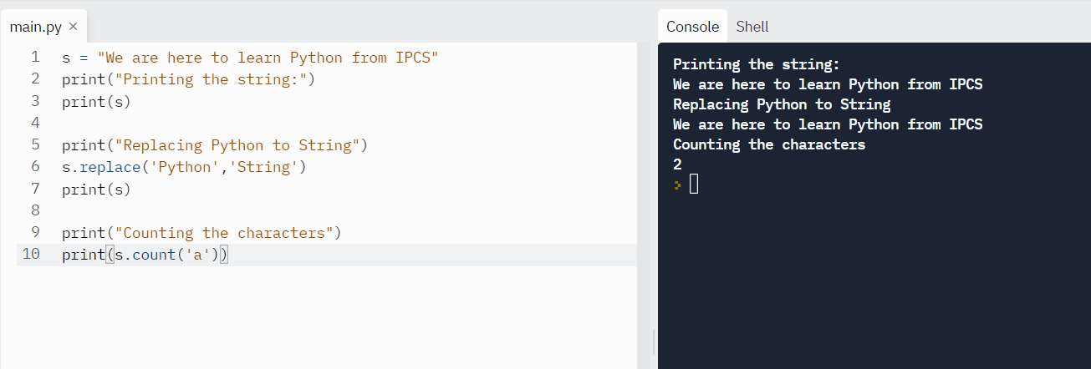

Slide 16
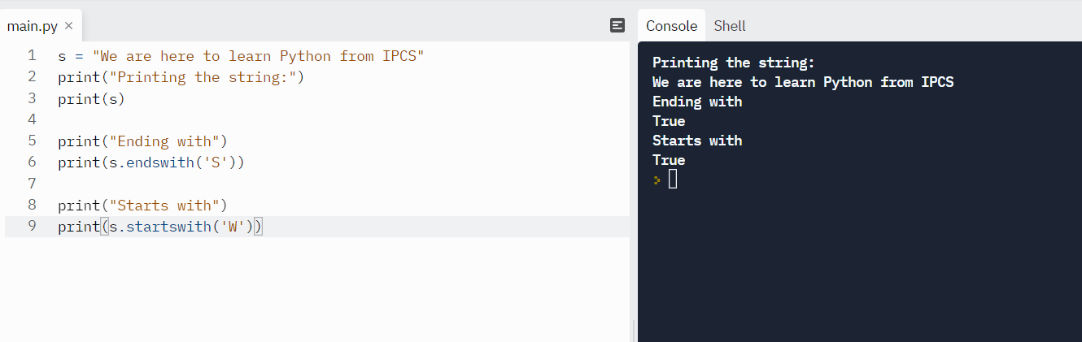

Slide 17
Question
S = “This is a class on Python”
Apply all the string functions on this string.
Like : upper ,lower ,title , replace,count,endswith, startswith

Slide 18
Boolean String functions
These functions will return true or false.

Slide 19
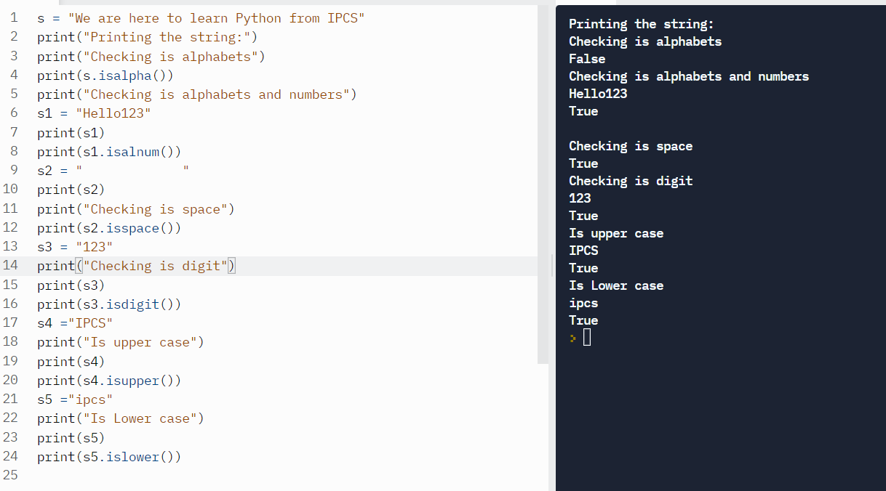

Slide 20
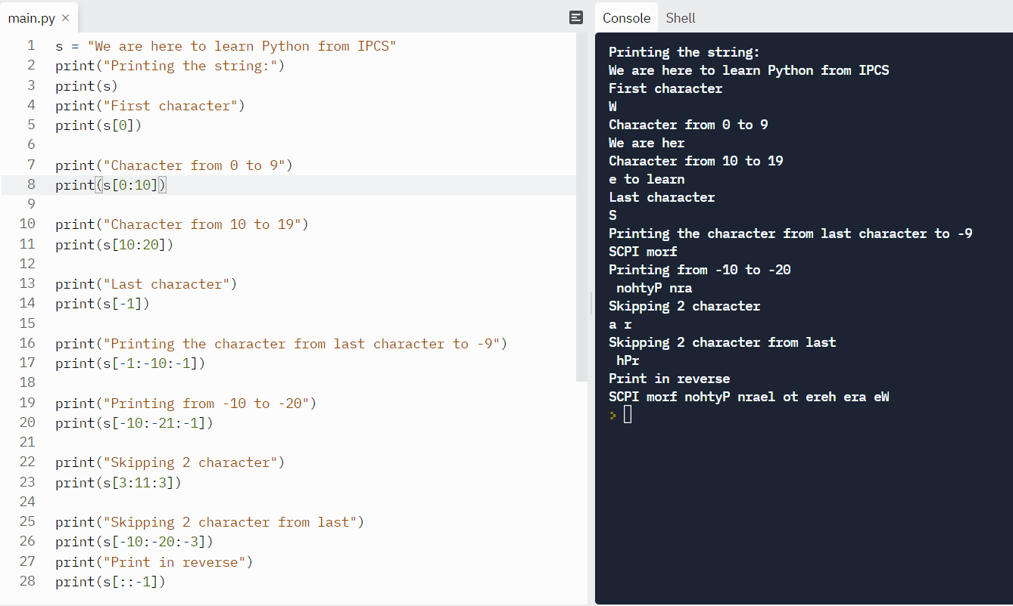
String Slicing

Slide 21
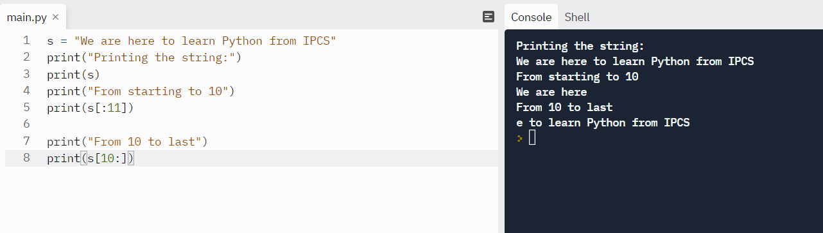
String slicing

Slide 22
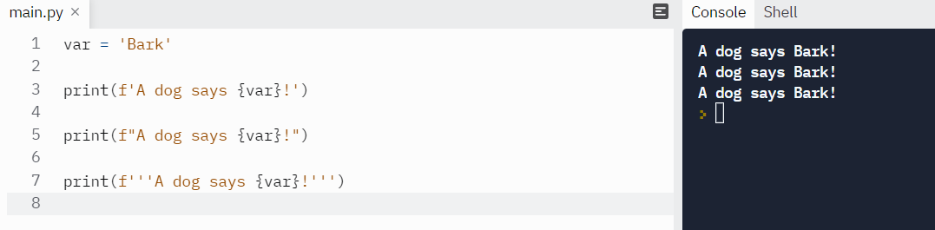
f string method

Slide 23
Question
Apply all Boolean function over a string.

Slide 24
Escape character
To insert characters that are illegal in a string, use an escape character.
An escape character is a backslash \ followed by the character you want to insert.
txt = "We are the so-called \"Vikings\" from the north."
Print(txt)
Output: We are the so called “vikings” from the north.

Slide 25
Escape Character
Code | Result
\' | Single Quote
\\ | Backslash
\n | New Line
\r | Carriage Return
\t | Tab
\b | Backspace
\f | Form Feed
\ooo | Octal value
\xhh | Hex value

